Slide 1
Earwells
Willamette ENT

Slide 2
Treatment of ear deformities in Infants
90% success rate when started before 3 weeks of age
Shorter duration of treatment if applied in newborn nursery or before 2 days of age
Average course of therapy 4-6 weeks (could be as low as 2 weeks if applied at 2 days)

Slide 3
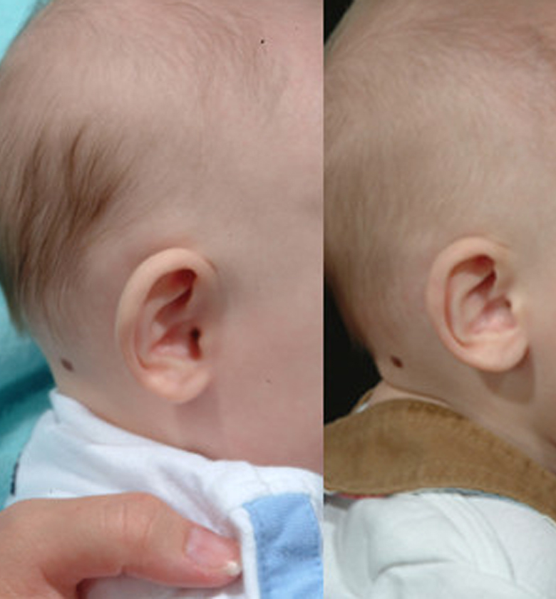
Prominent Ear
Normal projection behind the ear in newborn 5 mm
Abnormal >10 mm

Slide 4
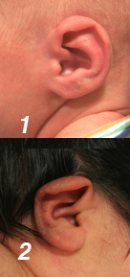
Lidding Deformity
Folding over of the superior 1/3 of the helical rim

Slide 5
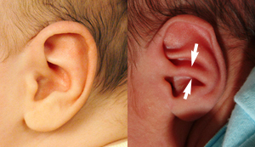
Conchal Crus Deformity
Raised cartilage bridge that divides the ear in half
Impacts aesthetics of ear and frequently accounts for increase in conchal-mastoid angle resulting in prominence of the ear

Slide 6
Helical Rim Deformity

Slide 7
Stahl’s ear deformity
Abnormal transverse crus arising from the antihelix of superior crus

Slide 8
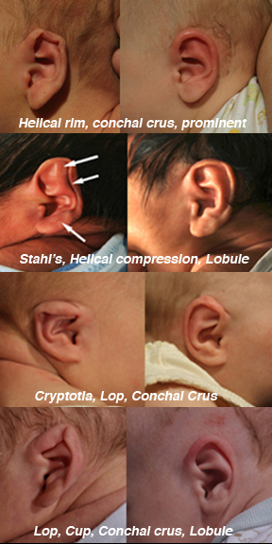
Mixed Deformity

Slide 9
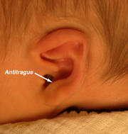
Lobule Deformity
Prominence of ear lobe generally due to cartilaginous problems –
inward tilting of antitragus
overgrowth of posterior conchal wall
increased conchal-mastoid angle

Slide 10
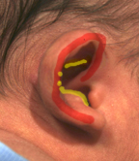
Cup ear malformation

Slide 11
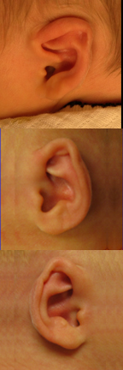
Constricted ear malformation
Ear smaller than normal
Helical rim appears unified with antihelix
Scapha missing or diminished in size
Lidding of superior helical rim

Slide 12
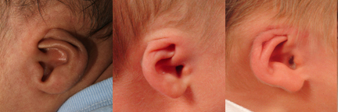
Cryptotia Malforation
Ear cartilage framework appears buried beneath the skin

Slide 13
Pre-Procedure- Communication with parents
Ear deformities are common amongst infants
Ear deformities will likely not resolve on their own
Many ear deformities can be treated with Earwell
Painless to child (although child may cry)
Does not affect the hearing
90% success rate

Slide 14
Pre and During Procedure- Parent instructions
Parents should feed baby prior to procedure
Ask parents to bring pacifier
To help calm baby
Place gloved finger (sugar water) in baby’s mouth
Consider swaddle of baby
Many babies will sleep through procedure

Slide 15
Post Procedure- Parent instructions
Examine cradle daily for any separation between adhesive and skull
Adhesive will typically last 14 days
When adhesive begins to separate from skin parents should apply tape and contact our office for re-application

Slide 16
Post Procedure- Parent Instructions
Keep cradles dry
Never remove anterior cradle
Clean only outside of cradle
Prevent milk or formula from getting into cradle
If baby spits up into or onto the cradle the child should be brought back to the office for removal of anterior shell and cleaning of the ear and interior components (vomit or food in cradle can lead to yeast infection)

Slide 17
Procedure
https://vimeo.com/81924911

Slide 18
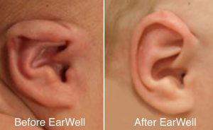
Before and Afters

